Slide 1



Project Title
STUDENTS NAME: Rohith Vijay R, Puneeteshwar,Akash Santhnu Sundar
COLLEGE NAME: Sri Sairam Instititue of Technology
BATCH :
REGISTER NO :
SUPERVISOR:
UNDER THE GUIDANCE OF:

Slide 2
JUSTIFICATION FOR SUSTAINABLE DEVELOPMENT GOAL
TITLE | PRIMARY | SECONDARY | TERITARY
GOAL
TARGET

Slide 3



Who we are
Name of your Venture: Fully Automated Robotic Systems (FARS)
Why ?
Explain why do you want to pursue this Business Idea.
The attendance log robot automates the process of recording attendance using technologies like facial recognition, RF-ID, or QR scanning. It identifies individuals and logs their presence accurately in real-time, reducing manual errors and improving efficiency. This system streamlines attendance tracking for institutions or workplaces, saving time and ensuring precise records.
What ?
Your goal when answering this slide should be to create enough interest about your venture.
Provide a brief on what does your venture do.
our team are developing a robot that automates attendance recording using facial recognition, RFID, or QR scanning. It identifies individuals and logs their attendance in real-time, storing the data in a secure system. The project involves designing, integrating technology, and optimizing performance for accurate tracking
How ?
Explain how your venture solves the problem and make its revenue.
We solves real-world problems by automating attendance, reducing manual errors, and saving time. It enhances transparency with secure, real-time logging and prevents manipulation.

Slide 4
Problem/Opportunity
CONTEXT When does the problem occur? In public spaces like hospitals, airports, and schools, where guided assistance, navigation, and attendance tracking are needed. | PROBLEM What is the root cause of the problem? Manual systems are inefficient and prone to errors, lacking accessibility features for elderly and differently- abled individuals. | ALTERNATIVES What do customers do now to fix the problem? Human attendants, maps, and standalone attendance software, which are error-prone and not integrated.
CUSTOMERS Who has the problem most often? Institutions such as hospitals, airports, elderly care centers, and schools. | EMOTIONAL IMPACT How does the customer feel? Customers feel frustrated due to inefficiencies, errors, and lack of accessibility in existing systems. | ALTERNATIVE SHORTCOMINGS What are the disadvantages of the alternatives? The manual processes lead to delays, errors, and difficulty for those with special needs.
 | QUANTIFIABLE IMPACT What is the measurable impact (include units)? Measure the impact in terms of reduced errors, improved operational efficiency, and higher accessibility.

Slide 5
Problem Interviews And Surveys Results
How many customers did you interview?
What was the interview mode?
How many of them agree this is a problem and wants a solution?
How many of them said they don't need a new solution?

Slide 6
Market Size Estimation
How to calculate market size?
Estimated Value: The global attendance management system market is valued at approximately $2 to $3 billion as of recent reports.
Growth Rate
Projected CAGR: The market is expected to grow at a compound annual growth rate (CAGR) of 10-15% over the next five years.
Key Drivers of Growth
Technological Advancements:
The integration of advanced technologies, such as artificial intelligence (AI), machine learning, and biometric recognition (fingerprint, facial recognition), is enhancing the accuracy and reliability of attendance systems.
Need for Accurate Record-Keeping:
Accurate attendance records are essential for compliance, payroll processing, and performance evaluation, driving organizations to adopt reliable automated systems.
Focus on Employee Engagement:
Companies are looking for ways to improve employee engagement and satisfaction, and automated attendance solutions can contribute by providing transparency and ease of use.
TAM
SAM
SOM
.
This slide is to provide details on Market Size and demonstrate How big is the market opportunity your venture is pursuing. Add source/reference to the data presented.
Sources: ……

Slide 7
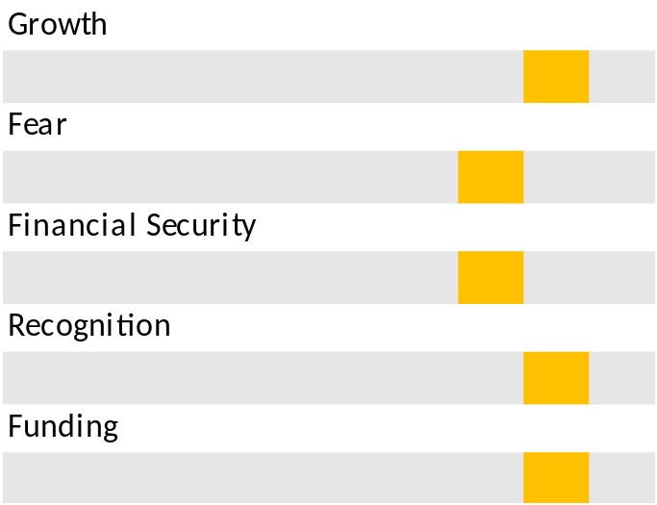
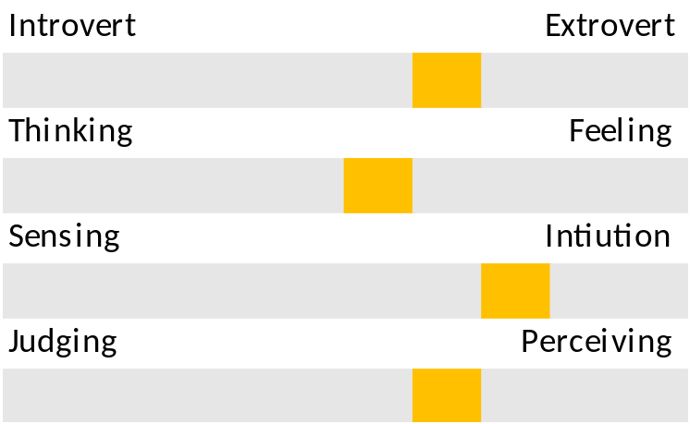
Customer Persona
Personality trait
Personality trait
Personality trait
Motivations
Photo
Goals
Frustrations
Ethos
Age:
Occupation:
Location:
The aim is to collect the information about your ideal customer persona who are likely to buy your product or service . It will help you tailor the user experience through targeted design.
Bio
Personality

Slide 8
Value Proposition Canvas
.
I would LOVE it if:
→ Automated navigation reduces time delays.
→ Face recognition simplifies attendance management
→Real-time guidance enhances customer experience.
→FARS provides personalized guidance for each user, enhancing overall efficiency.
→Scalable across multiple sectors, offering cost savings in human resources
I would WANT:
What do the clients do (actions) when facing the problem?
This refers to the feeling/action of customers before he gets in contact with your solution.
What is the product or service that you are offering?
FARS, a fully automated robotic system that enhances efficiency in public spaces by providing
real-time assistance face recognition-based
attendance logging, and navigation support.
GAIN CREATORS
GAINS
PRODUCT/
SERVICE
FIT
JOBS
PAIN KILLERS
PAINS
I would HATE it if:
→Manual logging is prone to errors.
→Visitors and patients find it difficult to navigate large institutions.
→Lack of real-time assistance impacts quality of care.
→FARS eliminates manual logging by automating attendance tracking through face recognition.
→It offers real-time guidance, reducing confusion in large spaces

Slide 9
Solution
Describe your Solution:
We offer: FARS, a fully automated robotic system that enhances efficiency in public spaces by providing real-time assistance, face recognition-based attendance logging, and navigation support.
The details of our offering consist of:
Automated Navigation: Guides users through large public spaces, ensuring they reach their destination efficiently.
Attendance Logging: Uses face recognition to automatically log attendance in schools, businesses, and hospitals.
Assistance for the Elderly and Differently-Abled: Provides special support and guidance, ensuring accessibility and ease of movement.
List the Benefits of Your solutions
Improved Efficiency: Reduces human error and saves time in operations.
Scalable Design: Easily adaptable across various sectors, from healthcare to retail.
User-Centric Design: Prioritizes accessibility, making it a perfect fit for hospitals and care facilities.

Slide 10
Competition Analysis
Benefits | Competitor 1 | Competitor 2 | Competitor 3 | Competitor 4 | Your Venture
Product
Price
Branding channels
Packaging
Market reviews
UVP
Add more as required

Slide 11
Lean Canvas
PROBLEM
EXISTING ALTERNATIVES
……………………………………………………………………………………………………………………………………………………………………………………………………………………
SOLUTION
……………………………………………………………………………………………………………………………………………………………………………
UNIQUE VALUE PROPOSITION
………………………………………………………………………………………………………………………………………………………………………………………………………
HIGH-LEVEL CONCEPT
………………………………………………………………………………………………………………………………………………………………………………………………………………………………………………………………………………………………………………………………………………………………………………………………………………
UNFAIR ADVANTAGE
?
?
?
?
?
CUSTOMER SEGMENTS
Visually Impaired Individuals: Primary target users who will benefit from navigation and object recognition features.
NGOs: Organizations working with differently-abled communities.
Government Agencies: Programs focused on enhancing accessibility and independence for differently-abled individuals.
Educational Institutions: Schools and universities looking to provide inclusive education tools.
EARLY ADOPTERS
………………………………………………………………………………………………………………………………………………………………………………………………………………………………………………………………………………………
Business Model (Explain with a process diagram)
KEY METRICS
?
?
?
?
CHANNELS
?
?
?
?
?
This canvas explains how the venture makes money (attracts, serves and keeps customers)
COST STRUCTURE
Production cost roughly estimated : $199.30 = ₹16,698.52
REVENUE STREAMS
Product sales, subscription services, partnerships, grants, customization services.

Slide 12
MVP
Provide Full product/service description
Insert a picture of the prototype
Provide video link of the working prototype, if any
Share screenshots of website ( Landing page, testimony etc.,). If the venture is in any online business, it must definitely showcase a functional website.
Share website link (If the venture is in any online business, it must definitely showcase a functional website.)
Share App link
Description of how the product will work and steps the customer will follow
Any other information
The slide helps to see your vision in action with a clear demonstration

Slide 13
MVP Validation
What is your MVP
A smart robotic system that uses machine learning to track student activities, logging precise entry and exit times. It simulates human-like eye movements to enhance interaction, aiming to improve classroom attendance and activity management.
Conclusion:
Test Details:
Persevere
Pivot
How long will we test this MVP?
Not conclusive
Who is our target audience for the test? How many of them?
How will we get to that audience?
Results of Test:
Realizations / Insights:
Did enough customers buy? Why or why not?
Did customers pay the price we expected? Why or why not?
Did customers come back to our product or show interest in doing so? Why or why not?
Next Steps:
Did customers recommend our product to others or evangelize about it? Why or why not?

Slide 14
Sales Plan
Customer Sales Funnel
Customer Acquisition Plan
TARGET MARKET:
?.........................
OPPORTUNITIES/PROSPECTS:
?.........................
CUSTOMER:
?........................
LEADS:
?.........................
1 | 2 | 3 | 4 | 5
Target Customer Segment (Type) | Target Customer Segment (Number) | Channels to be used to attract the target customer segment | Estimated number of leads | Estimated cost to convert these leads to actual customers
Ensure that the target market numbers are aligned with market sizing . The sales funnel is for one year

Slide 15
Go-to-Market Strategy
Ensure that you have active social media presence on multiple platforms – Facebook, LinkedIn, Instagram, Twitter, and others.
Show your branding video. Ensure that it:
  Is crisp and engaging
  Clearly explains the brand, the venture, its target customers, and unique value proposition.
Show your Positioning Statement. Ensure that it clearly states what your product is and what value it brings to the customer
Action plan to reach your sales/customer target for the next one year.
Show your Sales & Distribution model, clearly listing down your channels for both sales and distribution.
Note: You may use any other template of your choice to pitch for your venture as long as you cover all information being sought here.

Slide 16
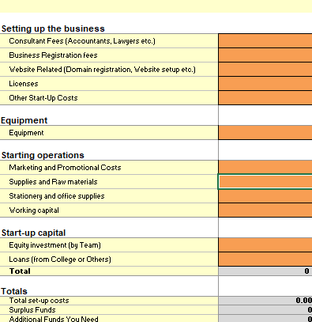
FINANCIAL PLAN
Start-up Costs
Place your logo here
Explanation:

Slide 17
Forecast P&L
Profit and loss forecast
JAN
FEB
MAR
APR
MAY
JUNE
JULY
AUG
SEP
OCT
NOV
DEC
Totals
Sales
₹ 51,00,000 ₹25,50,000 ₹ 51,00,000 ₹ 25,50,000 ₹ 51,00,000 ₹ 25,50,000 ₹ 51,00,000 ₹ 25,50,000 ₹ 51,00,000 ₹ 25,50,000 ₹ 51,00,000 ₹ 25,50,000
2 1 2 1 2 1 2 1 2 1 2 1
Cash sales
Collections from accounts receivable
Other cash receipts
Total Sales
51,00,000
25,50,000
51,00,000
25,50,000
51,00,00
25,50,000
51,00,000
25,50,000
51,00,000
25,50,000
51,00,000
25,50,000
0.00
COGS
2,50,000 2,50,000 2,50,000 2,50,000 2,50,000 2,50,000 2,50,000 2,50,000 2,50,000 2,50,000 2,50,000 2,50,000
Cost of goods sold
25,50,000
Gross profit
46,00,000
23,00,000
46,00,000
23,00,000
46,00,000
23,00,000
46,00,000
23,00,000
46,00,000
23,00,000
46,00,000
23,00,000
0.00
Operating Expenses
Salaries and Consultant Fees
7,90,000
7,90,000
7,90,000
7,90,000
7,90,000
7,90,000
7,90,000
7,90,000
7,90,000
7,90,000
7,90,000
7,90,000
94,80.000
Marketing and Promotion
20,000 20,000 20,000 20,000 20,000 20,000 20,000 20,000 20,000 20,000 20,000 20,000
0.00
Utilities (Electricity etc.)
10,000 10,000 10,000 10,000 10,000 10,000 10,000 10,000 10,000 10,000 10,000 10,000
1,00,000 1,00,000 1,00,000 1,00,000 1,00,000 1,00,000 1,00,000 1,00,000 1,00,000 1,00,000 1,00,000 1,00,000
0.00
Transportation (Shipping, Courier, Taxis etc.)
0.00
Office Supplies
0.00
Repairs and Maintenance
0.00
Office Supplies
0.00
Misc. Expenses
0.00
Interest on Loan
Loss, Theft, Wastage
0.00
Total Expenses
0.00
0.00
0.00
0.00
0.00
0.00
0.00
0.00
0.00
0.00
0.00
0.00
0.00
Result
Net Profit/Loss
33,00,000
11,80.000
33.80,000
10,80.000
33,80,000
10,00,000
33,80,000
10,80,000
33,80,000
10.80.000
3,80,000
10,80,000
0.00
Gross profit margin
90% 90% 90% 90% 90% 90% 90% 90% 90% 90% 90% 90%
66% 42% 66% 42% 66% 42% 66% 42% 66% 42% 66% 42%
Net profit margin

Slide 18
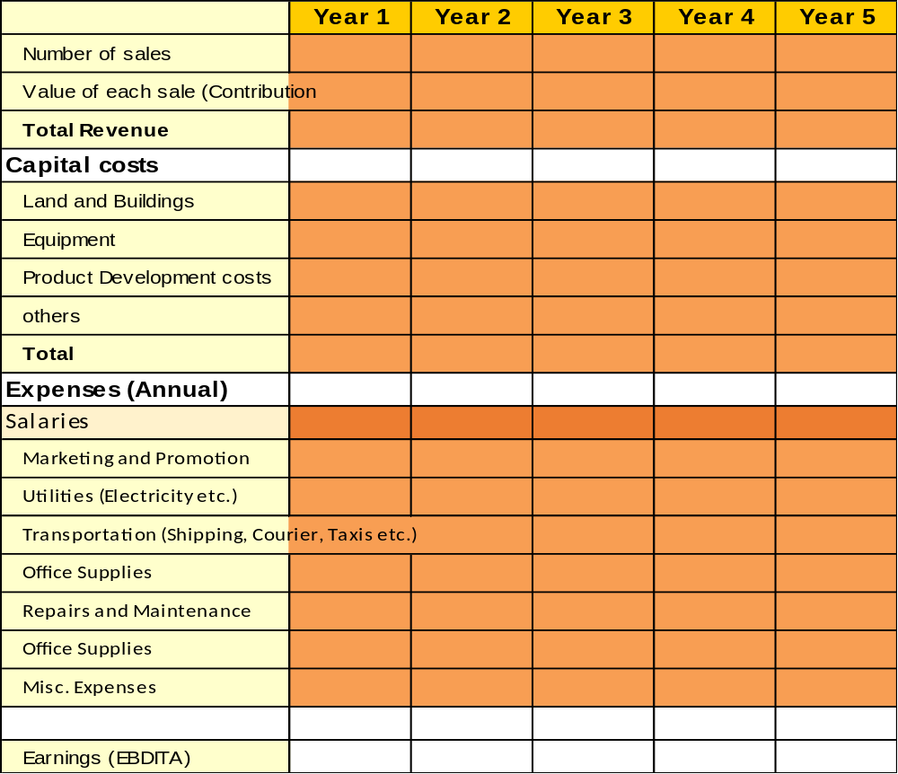
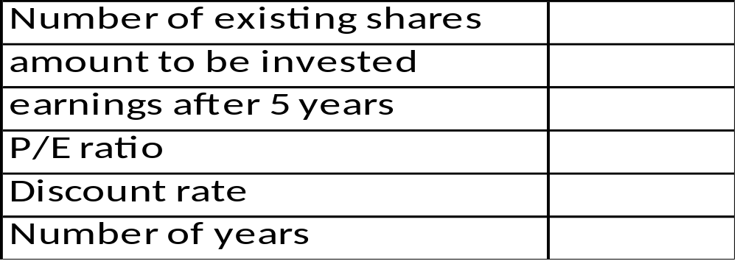
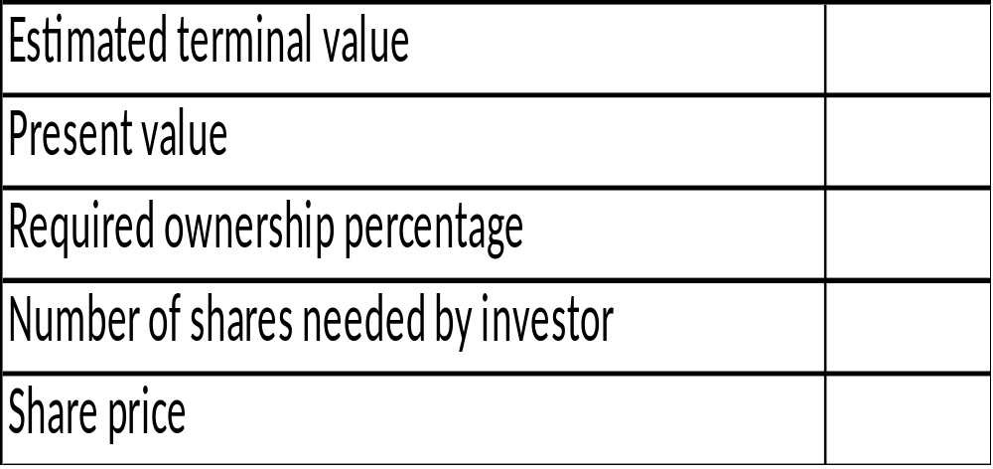
Financial Projections

Slide 19
Unit Economics
P & L/ unit | Year …..
Revenue
COGS
Gross Profit
Gross Profit Margin
Operating Costs
Operating Profit
Unit Economics | Year ……..
CAC
CLV
ARPU
Assumptions (Year……..)
The above is the Unit Economics for year 1 (year ……). Refer to P&L statement for year 1 in slide 16.
​Terms | Explanation (For the actual calculations, refer to the Financial Plan Excel sheet link)​
CAC​ | (Cost of Sales + Cost of Marketing ) / Number of new customers acquired (in currency terms)​
CLV | Average purchase value x Average purchase frequency x Average Customer Lifespan x Gross Margin
ARPU​ | Total revenue in specific period/Total number of customers during the same period (in currency terms)​
GROSS PROFIT​ | Total revenue – Total COGS (In currency terms)​
OPERATING COSTS | Cost of goods sold (COGS) + operating expenses (OPEX)
OPERATING PROFIT | Revenue from Core Operations – Cost of Goods Sold – Operating Expenses – Depreciation – Amortization Expenses
CHURN RATE | (Customers at the beginning of the period – customers at the end of the period) / customers at the beginning of the period

Slide 20
Funding Plan
How much funds required to reach to the next level of the venture?
?
How much have been bootstrapped? If not, why ?
?
How much can be bootstrapped?
?
How much external funding required? If not, why?
?
Funds utilization strategy (Details)
?
?
?
?
?
?
?
?
?
?
?

Slide 21
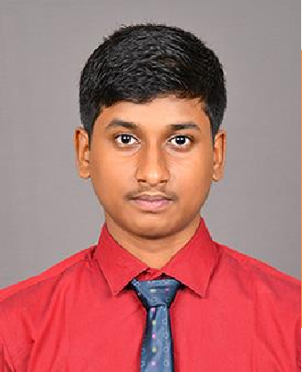
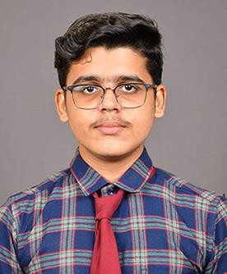
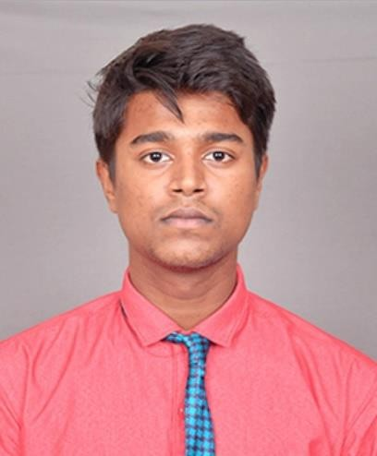
Team Composition
Team member 1
Team member 2
Team member 3
Picture
Picture
Picture
What makes us a good team to solve the problem we chose?
Role/Position:
CEO
Role/Position:
COO/CTO
Role/Position:
CFO/CMO
Key Strengths and abilities :
Programming
Designer
R & D
Networking
Key Strengths and abilities :
3D Modeling
Editing
Debugging
R & D
Key Strengths and abilities :
Hardware troubleshooting and benchmarking
•R & D
•Networking

Slide 22
Thank You!

